Slide 1

Sorting pills: delicate task
Following a medical schedule is a repetitive task, which requires prospective memory.
Such a delicate task gets harder to perform with aging.
Due to the growth of elderly population, more people risk ingestion of incorrect dosage from sorting.
Fig 1: https://farmaplan.com.do/media/zoo/images/La-automedicacion-y-sus-peligros_175a60dbbf88ca9b86bad026360f63d0.jpg

Slide 2
R.A.Pi.D Reliable Autonomous Pill Dispenser

Slide 3
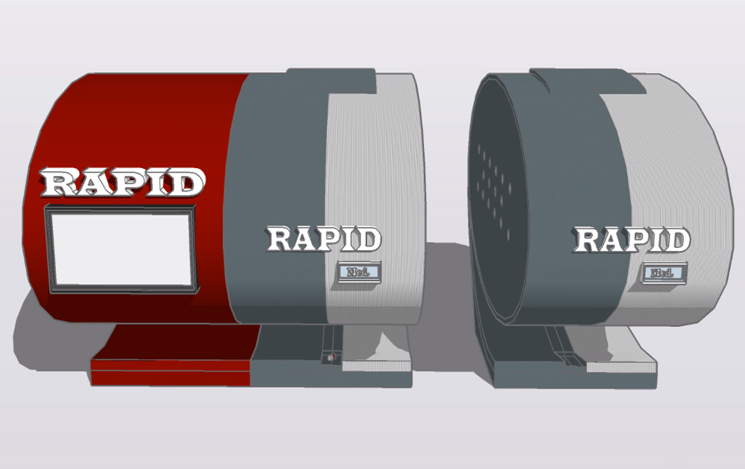
Characteristics
Store and automatically dispense pills
Smart
Affordable yet robust
Safe and reliable
Modularity and scalability
Easy maintenance and repairability
Convenient

Slide 4
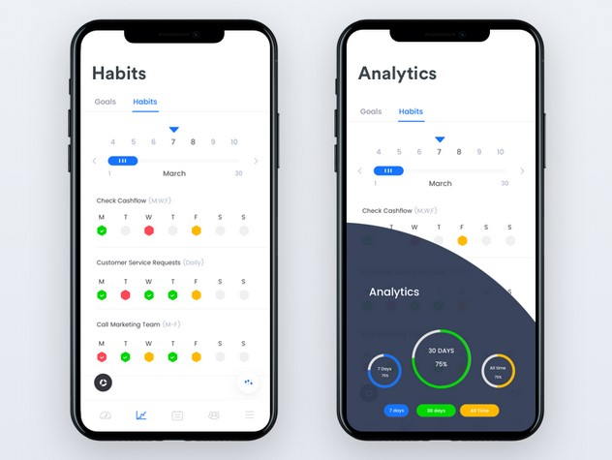
Features
Once downloaded the RAPID app, the schedule can be inserted remotely.
One setup uninterrupted operation.
The device will alert the user to take pills through sound alarms.
Important information are displayed on the app.
Any warning is received by the caregiver through push or email notifications.
Fig 2: https://miro.medium.com/max/1600/1*r4AlTTp20LS5w7C-Vvs4Hw.png

Slide 5
In a nutshell...
More tranquility and peace-of-mind for your family
Pill adherence tracking
Much cheaper than similar solutions
Modular: buy just what you really need

